Slide 1

Course Overview
Module 1 – What is Bid Writing?
Module 2 – Organisation Background
Module 3 – Project Details & Budget
Module 4 – Evidencing Need
Module 5 – Demonstrating Outcomes
Module 6 – Prospecting: Finding the right Funds
Module 7 – How applications are assessed
Module 8 – AI in Bid Writing
Module 9 – Maximising Success Rates
Module 10 - Summary & Reflections
Post Training - Signposting and links to further resources
Notes:
Module 1 – What is Bid Writing?
Module 2 – Organisation Background
Module 3 – Project Details & Budget
Module 4 – Evidencing Need
Module 5 – Demonstrating Outcomes
Module 6 – Prospecting: Finding the right Funds
Module 7 – Simple Bid Writing
Module 8 – How applications are assessed
Module 9 – AI in Bid Writing
Module 10 – Maximising Success Rates
Summary & Reflections
Post Training - Signposting and links to further resources

Slide 2
What is Bid Writing?

Slide 3
What is Bid Writing?
Written request in the form of application form/letter
Criteria and Guidance to meet
Competitive process
Prioritise time & resources
Notes:
Start by explaining what it is. Some of them may be relatively basic, but also some important points too that have to be said.
Typically, some criteria that we will have to meet i.e. geographical, charity size etc.
Other funders have looser criteria. But generally dig deep and learn what they like, don’t like and what they really want to fund (talk about later)
Be really clear about what a funder likes/doesn’t like before spending your valuable time on it.
Level of competition that will mark success – competing against other charities. The name of the game.
But not chasing perfection – good solid grant applications.
Bid Writing still one of the most cost effective forms of fundraising – highest ROI across FR streams.
Bid Writing should be proportionate. When bigger pots of funding – more time/resources and expectations.
Weigh this up when doing the prospecting. Be aware of any grant conditions.

Slide 4
Key Sections of an Application

Slide 5
Key Sections of an Application
Organisation Background
Project Details
Budget
Need
Outcomes / Outputs
Specific Supplementary questions
Notes:
How to apply – online vs postal. Depending on funder preferences. Covid-19 shifted lot of funder to accepting online applications.
Sometimes ask for case for support – essentially charity and project summary.
Application forms typically have these 6 sections within them – key information to include in an application. Will be asked in different ways.

Slide 6
Organisation Background

Slide 7
Activity
In no more than three sentences can you describe your organisation, whilst including the following information:
Organisation type
Where you are based and operate
Year established
Aim and objective
Number of staff/volunteers
Main activities
Notes:
Have a little go at writing your elevator pitch. Grab my attention and summarise what you do. Give a good first impression.
Do it on piece of paper or in the chat box. Give 2-3 minutes to do this.
And then we’ll ask for some people to shout them out or write them in the chat box. And give some live feedback.
If that doesn’t make sense, just shout at me.
Feedback – written what has said. But go above and beyond. But what we find, don’t use it as an opportunity to sell yourselves and just do the basic.
I want to see what makes your organisation special, the personality, the phrases that matter. Your USP. Transformational impacts on your clients.

Slide 8
Organisation Background
Regular Mistakes
Check the following are correct:
Registered Organisation Name
Year Established
Organisation Legal Structure
Financial inaccuracies
Matching information on your website
If something may cause confusion, provide an explanation.
Notes:
Need to get the basic info right. So many get this wrong.
Be upfront and be able to explain i.e. financial position / reserves position. Things that we know may put of funders. Being proactive.
In my last charity, our reserves position. Struggled previously with funders. Then added statement into our accounts about WHY. Improved our success rate the next year.

Slide 9
Project Details & Budget

Slide 10
Project Details
Who, what, how, where, when…
Service design – why this model of delivery?
Clear and concise
Evidence and justification
Reflective of project budget
Notes:
Your opportunity to explain all the logistics of what is going on.
What’s the plan – be really clear and concise about this.
Service design – explain why you are doing it in this way and it makes sense for your community etc.
After reading this, the assessor should have a clear understanding of how the project is going to work

Slide 11
Project Budget
Start with project then Budget
Clear budgets prove Credibility
Create a budget for every application
Emphasize key budget elements in application
Notes:
Start with the Project
Then Budget
Why
Eligibility
Confirms you know the project
Know what to include in application
Importance of budget elements
Ward off Budget Changes
Funders like:
Accuracy
Eligible Expenditure
Explains the Project
Reflecting the Project (details in application)
Justifies Anomalies

Slide 12
Evidencing Need
Notes:
Hit by 10:45.

Slide 13
Activity
What are the different ways you can argue the need within an application form?

Slide 14
Evidence of Need - Internal
Community Consultation
Anecdotal evidence
Requests from local people
Requests from local agencies
Local Surveys
Focus Groups
Case Studies
Waiting Lists from previous projects
Notes:
Anecdotal – though community consultation. This is that need that we have seen show up. Within the mix of other arguments.
Requests from local people – how many people, who, what kind of people. Already identified need for 10 locals…
Requests from local agencies – local partners not able to fill gap but identified a need.
Consultation – surveys from local people. Easier way to do it i.e. via SurveyMonkey. End of an event, ask people a question to get consultation idea.
Case studies – can be a really powerful tool. Brings an application to life. Emmotive language. Instead of using paragraph long quotes, summarising it into 1-2 lines. More powerful.
Be realistic with what level of community engagement you can have.

Slide 15
Evidence of Need - External
Data collection
External data/statistics
Research Documents
Charities own research
Notes:
External data/stats – some of the strongest need you can identify. Deprivation indices of your area/community. Local age groups isolation stats. Whatever it may be.
REFER to Evidence of Need handout that will include in follow up emails.

Slide 16
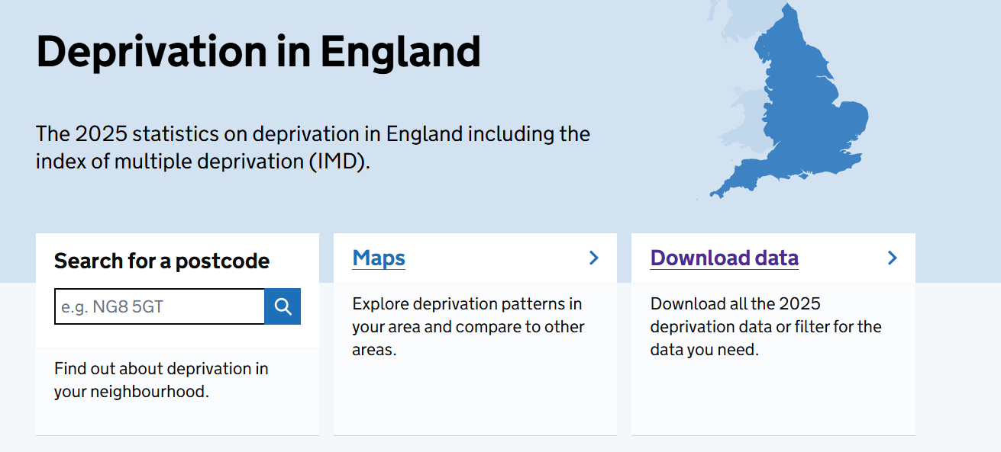
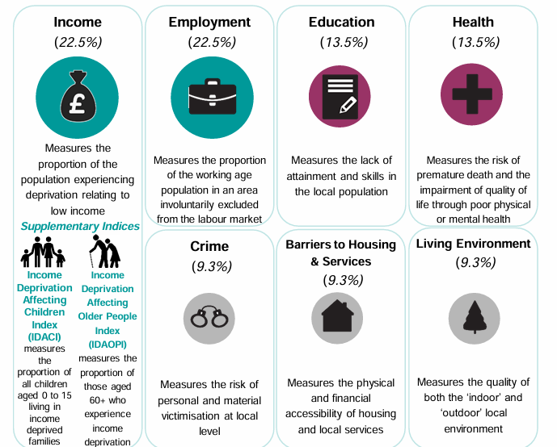
Evidence of Need – IMD
English indices of deprivation 2025 - GOV.UK
Notes:
External data/stats – some of the strongest need you can identify. Deprivation indices of your area/community. Local age groups isolation stats. Whatever it may be.

Slide 17
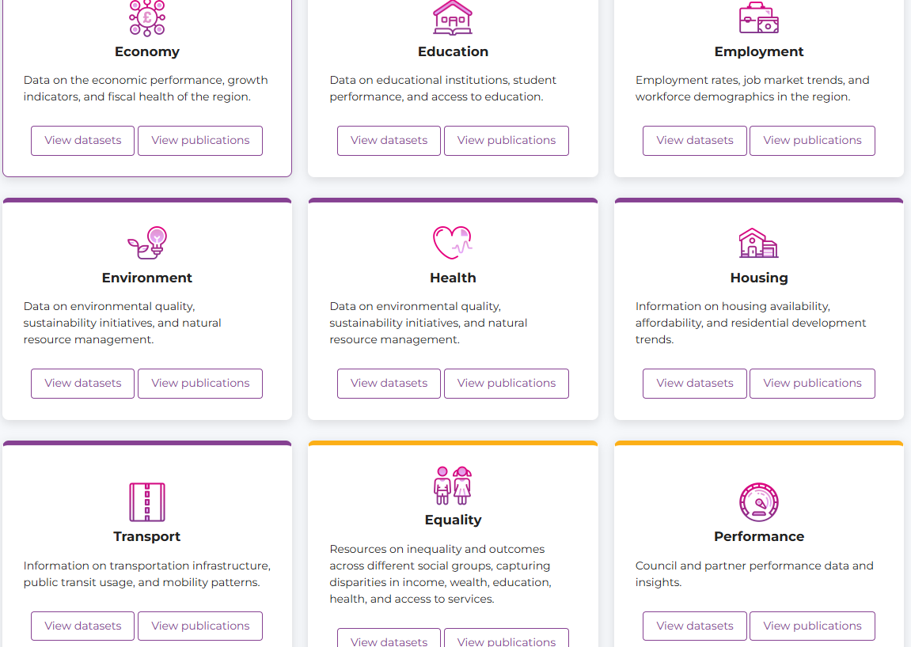
Evidence of Need – Local & Regional
Council Local and regional data
Homepage — Birmingham City Observatory
Notes:
External data/stats – some of the strongest need you can identify. Deprivation indices of your area/community. Local age groups isolation stats. Whatever it may be.
EXAMPLE from Birmingham City Observatory looking at evidence of need in specific areas on local and regional level. Wherever you are based find this data locally and regionally.

Slide 18
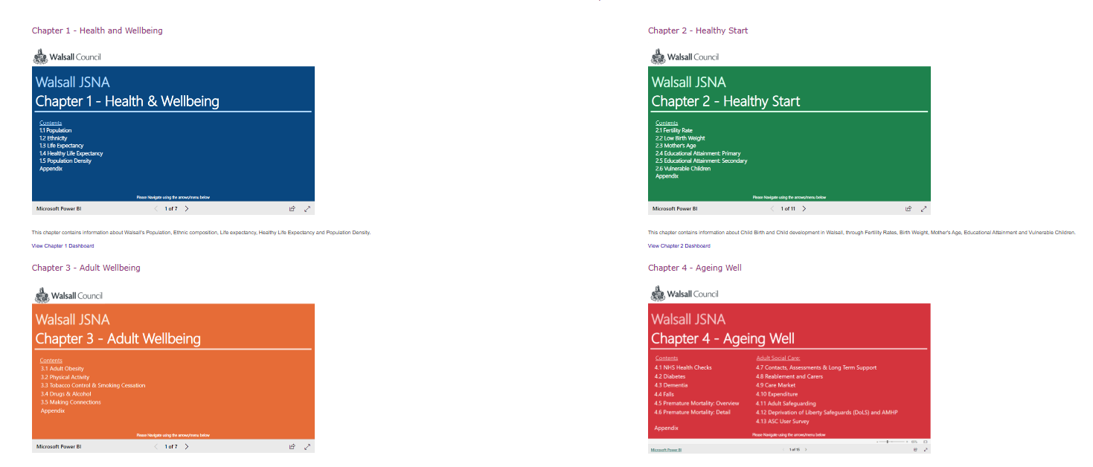
Evidence of Need – Local & Regional
Joint Strategic Needs Assessment
https://www.walsallintelligence.org.uk/
Notes:
External data/stats – some of the strongest need you can identify. Deprivation indices of your area/community. Local age groups isolation stats. Whatever it may be.
EXAMPLE needs assessment of local authorities – this may look different for each area. But myriad of data within there.
How the need taps into regional but also national needs assessments

Slide 19
Handout
See Get Grants Evidence
of Need Handout
Notes:
Ask to share in chat box if no time to open up for mini chat.
REFER to Evidence of Need handout that will include in follow up emails.

Slide 20
Activity
Think about the different methods of identifying need that you can use in an application.
Can you think of example need
statements for your organisation?
Notes:
5 minutes to do activity. Put it in the chat box.
Give me an example of how you do it / would do it in an application. And we can talk through it.
Use of stats / hearing voices of beneficiaries vs we believe this because we think this is how it is

Slide 21
Need - Top Tips
Tailor ‘problem statement’ for each funder
Use a mixture of ‘internal’ arguments and external statistics
Create a document on ‘banked’ arguments, evidence and statistics to reuse answers
Research local, regional and national evidence and use the strongest possible evidence
Use Google or AI to help collect evidence
Notes:
Can be one of the easiest sections – using the same statement over and over. Keep figures up-to-date. Conduct further similar research.

Slide 22
Demonstrating Outcomes

Slide 23
Activity
Can you identify the different outcomes of the following project?
An Elderly Luncheon Club
Notes:
2-3 minutes – in chat box let us know some different outcomes for Elderly Luncheon Club.
Core outcomes – what a project is set up to achieve. Think back to previous imaginary organisations – reduce crime.
Alternative outcomes – additional benefits of beneficiaries taking part.
Why would we be getting elderly group together? – isolation / loneliness especially in face of Covid BUT also physical health/fitness/sport skills etc, Talk about walking rugby projects and benefits.
The aim of this activity is to identify all the potential outcomes – help us to identify all funders that are potentially interested in meeting the outcomes. Go away and try this.

Slide 24
Outcomes
Core Outcomes
Additional Outcomes
Developed Outcomes
Alternative Outcomes

Slide 25
How to present your Outcomes
Outputs: What you will deliver.
e.g. “We will deliver 2 annual Family Residential attended by 10 families and 25 individuals in total”
Outcomes: What changed in the short-term.
e.g. “Disadvantaged parents experience increased peer support and decreased isolation ”
Impact: The bigger, longer-term difference.
E.g. “Parents report new friendships, feeling more connected with a community and reduced social isolation next year”
Notes:
Difference just to be aware. Fundraisers can get confused about this and equally funders can get confused about this too (haha).
Output – measurable deliverable. What you are going to do or what you did. Linked to delivery. Going to be numbers associated with it.
Outcomes - What is being brought about as a result of your project (short-term).
Impact – longer term change and positive difference. Useful to think of context of debt-advice as positive outcome can come months after an initial session.
Difference is important because in an application – they will generally always ask outcomes section. But not always called that.
The impact / change / benefit / difference – types of phrases funders use. Be aware of it.

Slide 26
Top Tips for Outcomes
Be specific: “80% report improved confidence”.
Give context: Show before/after or baseline vs endline.
Use the funder’s language: Mirror their outcomes wording.
Avoid vague verbs: “Helped” / “Supported” / “Improved” → say what changed & for whom.
Quantify change with numbers or %

Slide 27
Monitoring & Evaluation
Balance heart and head – Combine stories with evidence.
Make it doable – Build in M&E into every day practice without burning out.
Be clear, not perfect – Funders want honesty and learning.
Impact builds trust – It's key to stronger fundraising.
Notes:
Briefly basic top tips – demonstrate credibility
Doesn’t have to be fancy
Basic tracking of positive outcomes to explain impact
Key message: Everything you measure should link back to your mission and the needs you exist to meet.

Slide 28
Prospecting:
Finding the ‘right’ funds

Slide 29
Finding funders
Finding the ‘right’ funders
Targeted approach
Initial detective work
Speak with them – seek the golden nuggets
Notes:
STARTING POINT - Finding the ‘right’ funder that aligns with your charitable organisation, your cause.
And whose basic criteria and eligibility that you meet.
When times are tough, we tend to panic and apply to any old funder or wherever people tell us there’s money.
Is that the best use of our precious time and resources? Do good prospecting. Think about who’s right for us.
Targeted search rather than a shot in the dark scattergun approach. Think about how you’re spending your time.
12000 UK grant funders. Can’t be expected to go through an A-Z of all these (like I used to think ha).
So make sure you’re hitting that criteria and eligibility.
Expect funder to be doing (at least some) due diligence, eligibility checks.
Otherwise fitting square peg into a round hole. Not the most effective approach.
Proactive with this vs being reactive and firefighting to fill a gap.
Meeting funders needs balance of combining requirements of funder and your own needs. Adapting to meet requirements BUT not if it doesn’t make sense for you.
No matter how amazing your application is, so many fall down by not spending the time doing this initial detective work.
Prospecting is so important to get right.
Where you’re unsure if you’re the right fit, and where possible have conversations with funders.
Make sure it’s not something obvious from their website.
Clarify your criteria / which project may be right fit.
To help you ultimately decide if it’s the right funder for you or not.
Disappointing if not right fit – but saves you so much wasted time putting together an application.
Golden nuggets - often ends up getting way more information that you expected.

Slide 30
Activity
What are the different ways in which you research or find out about funders?
Notes:
2 mins to complete activity.
Next slide for answers.

Slide 31
Finding Funders
Previous funders
Existing knowledge
Online Databases
Charity Commission
Local Advice – CVS / Local Authority
Other groups’ funders
Networking
Google / Exploring AI
Relevant Newsletters
Notes:
Charity Excellence Framework / Directory of Social Change / Get Grants have funding finder
Charity Commission (advanced search tool).

Slide 32
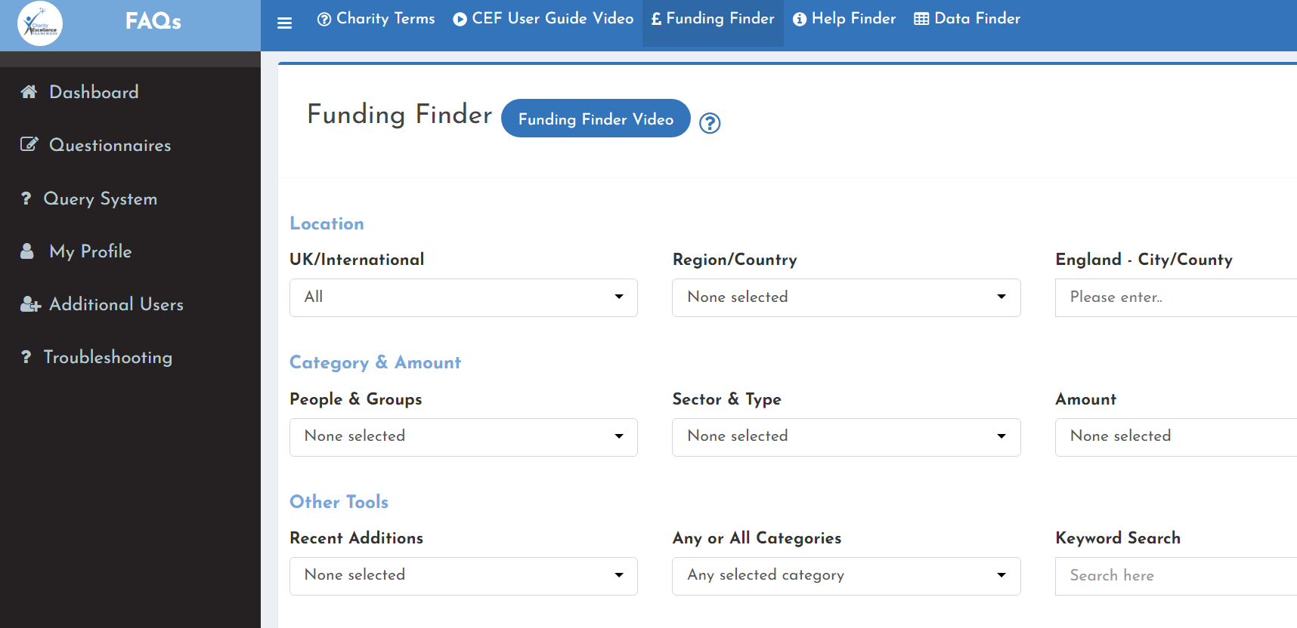
Online Databases
Charity Excellence Framework
Notes:
Removal of My Funds Online and DSC

Slide 33
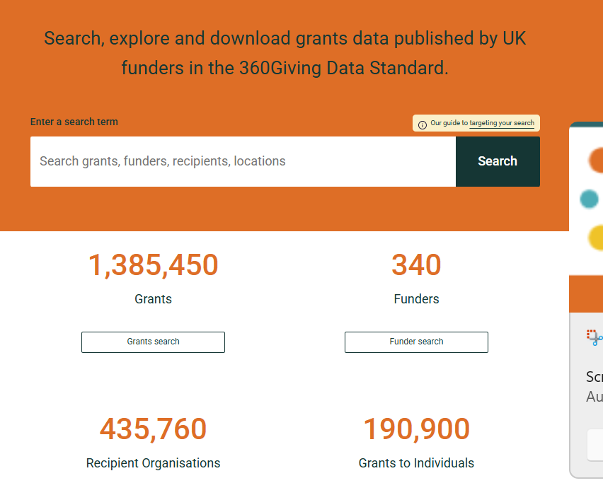
360Giving Data
Finding the funds
360Giving GrantNav - Home
Notes:
Looking at history of grants e.g. debt advice funders. Huge amount of data and insights.

Slide 34
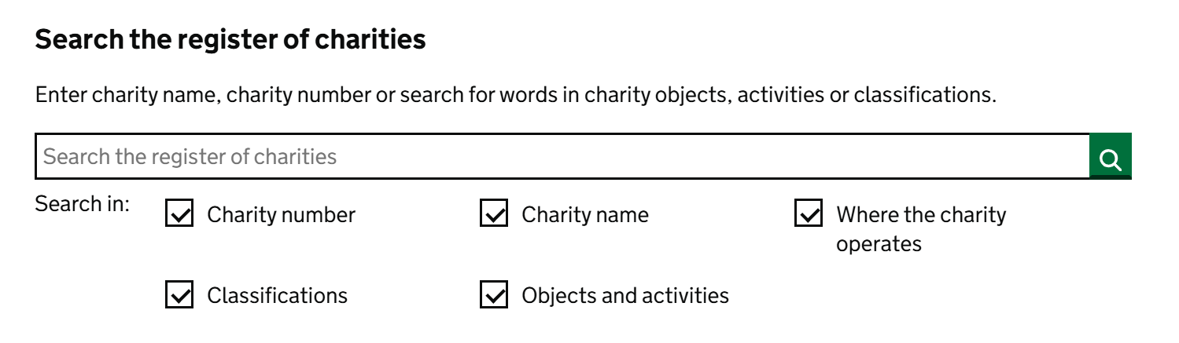
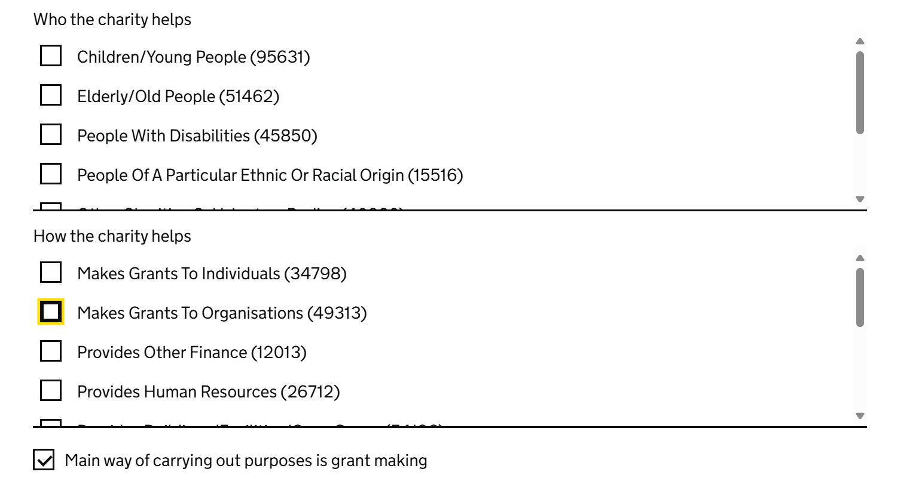
Online Databases
Charity Commission
Notes:
Removal of My Funds Online and DSC

Slide 35

Finding the funds

Slide 36
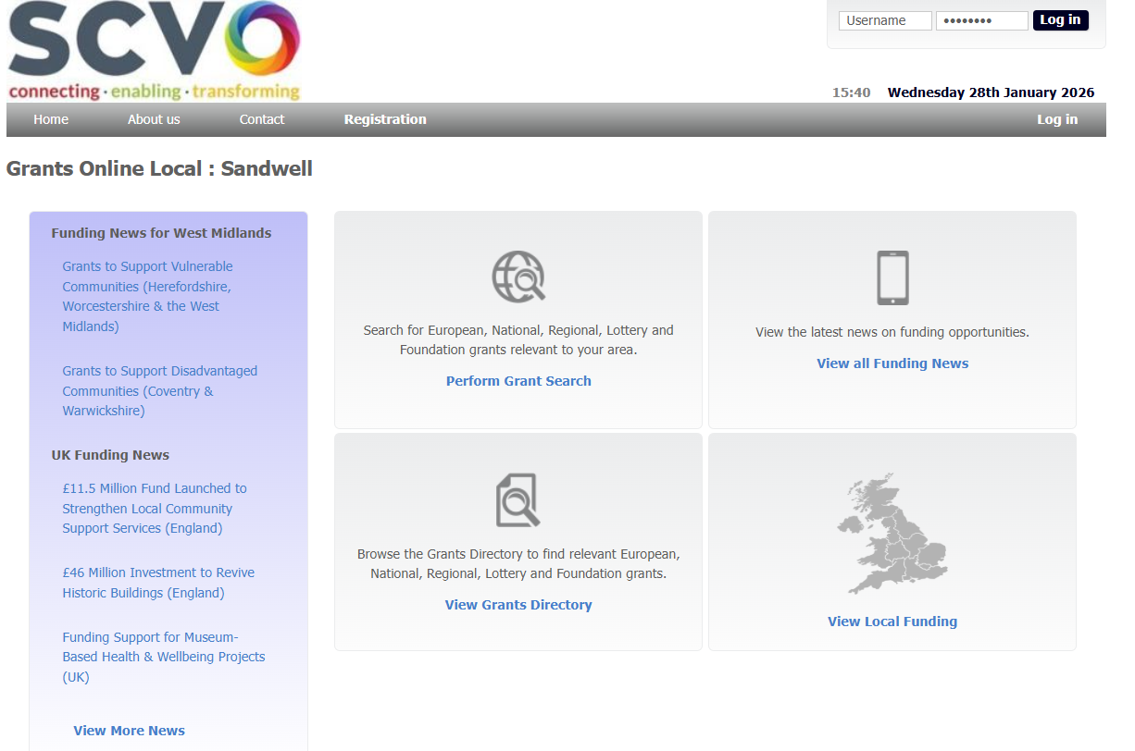
Local Advice
Finding the funds
Notes:
Added more updated screenshot

Slide 37

Local Community Foundation
Finding the funds
Notes:
Added more updated screenshot

Slide 38
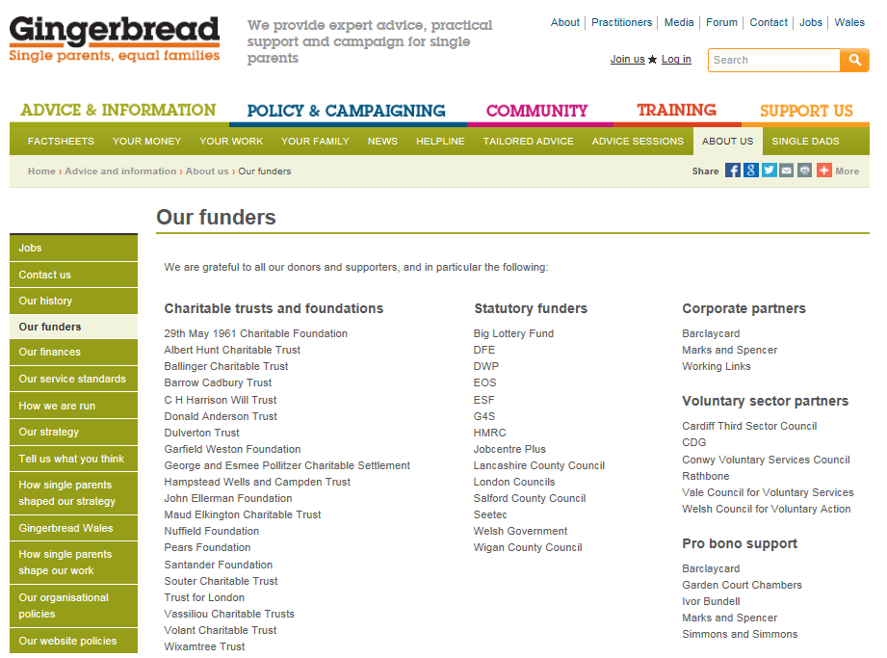
Other charities’ funders
Finding the funds
Notes:
Looking at competitors. Not re-inventing the wheel.
Cross reference with your list.

Slide 39
Getting to know your Funder
Funders website
Read and re-read Grant Guidelines
Check for details of recent grants
Case Studies
External references
Application form
Speak to them
Notes:
They have a set amount of money to give away to meet their objectives.
They are giving us money to do work that meets their objectives.
GrantNav, search who they’ve given money to before.
Charity Commission – annual accounts. See if they have a list of grants distributed. The majority outline who and how much they’ve given.

Slide 40
Simple Bid Writing

Slide 41
Simple Bid Writing
Find a funder interested in the same social objectives as your work
Evidence Need for you work
Demonstrate the outcomes you will achieve
Prove you can do the work
Notes:
Strip it back in its simplest terms. The most important sections of application:
Identify
Prove you can do work – market yourselves as a credible organisation.
If you do these 4 bits well, you’ll see success.
The more you write, the more confidence you’ll get.

Slide 42
How Applications are Assessed
Notes:
Going to send you 3 applications forms to review.
Read score and assess based on assessment framework – like we use for job interviews.
Only spend 10-15 minutes to do this activity. Come back next week and discuss.
Depending on time quickly go through next couple of slides…
Skip to slide 39 to end on this one…

Slide 43
Assessment Process
Due diligence & initial eligibility checks
Applications scored against an Assessment Framework
Recommendations made by Assessor/Grants Officer
Final Decisions by Trustees/Senior Management
For larger grant programmes, may be additional stages
Notes:
Do not give the funders a reason to reject you and put a cross next to your application.
Think about it from their perspective. Quick double check before submitting / reviewing all the criteria of the funder beforehand.
Assessment framework – trying to make it a transparent process. Each application set out against this.
Assessors making assessments, giving you a score based on what you have sent to them.
For larger grant programmes, be aware there may be additional stages in this process – panel meetings, telephone assessment, site visit. E.g. MaPS.
Large programmes where assessment panel used, also can require ministerial approvals eg all MaPS grant programmes need approval from gov due to value and duration

Slide 44
Credibility in Assessments
Funders are asking themselves two questions:
Do we trust you enough to give you a grant?
Do we believe you can deliver this project?
Notes:
Importance of presenting yourselves as a credible organisation.
Will impact your chance of success.
Will come back and explore what this looks like in practice throughout today.

Slide 45
Important Reminders
Check bid responds to criteria & guidelines
Accessible language for audience
Meet dates & deadlines
Ensure word counts met
Avoid missing / incomplete information
Proof read before submitting
Notes:
Make sure your bid responds to all criteria and guidance asked for by funder.
Think of your audience – be clear. Avoid ambiguity or assumptions.
Have one clear voice throughout application – especially if multiple people contributing to narrative (or bid done in partnership)
Don’t miss out on deadlines – prioritise. Ideal time – new funders / new grant programmes. Look at funder deadlines / when they meet / when they make decisions. Particularly in light of early closing grant windows.
Word counts – important to fall within this or may not get assessed. Character count vs word count.
Proof read – to avoid heartbreak and make sure not made any silly mistakes.
These things will impact our chances of success.

Slide 46
Application Assessment
Using the Assessment Framework read the three example applications to a Crime/ASB grant programme and individually score each application
Make some comments on the applications as you assess them and ultimately decide what you would fund & not fund.
Notes:
5-10 minutes discussing - Any thoughts about the activity? How did you get on? Initial thoughts / feedback?
Subjective elements to assessing – where your application lands. How harsh / flexible / personal biases whether unconscious or not.
We all have those causes/areas that we just care or are more passionate about.
Write in the chat box the score you gave for each imaginary organisation. We’ll see if there’s consensus.
Anyone happy to turn their mic on and talk through what they liked / didn’t like in any of the applications. Or if not able to speak, drop your thoughts in the chat box.
Bromsgrove (32 out of 40) – Conducted a pilot. Track record. Credibility. Numbers/figures/references. BUT scored down on legacy / outcomes.
Burslem Youth (25 out of 40) – Good longevity of project. Sustainability element. Numbers/figures/references. BUT youth club project. Not much about police/anti-crime.
Essex Eagles (14 out of 40) – ignoring the leading questions. Not understanding the issues/needs of participants. Wording and writing style. Lack of project detail. I believe it could well be a well-developed project, but they just haven’t explained it as such. Could really do with a peer review.
Tips - As fundraisers, we are the bridges of communication from participants to funder. We need to translate this. Convey this to a funder who has no idea about you.
Mention value for money – cost per participant. Not many funders (but Sport England) focus on this because it can be so different across projects. Intensive support vs widespread. Judgement call. 12 participants vs 100 participants for the same project. Can’t compare.
Overall – Applications aren’t that great. But the top 2 over 25 would have a decent chance. Hopefully you go away and take away with you that you can write applications to this standard.

Slide 47
How Applications are Assessed:
Bromsgrove Community Trust
Notes:
Going to send you 3 applications forms to review.
Read score and assess based on assessment framework – like we use for job interviews.
Only spend 10-15 minutes to do this activity. Come back next week and discuss.
Depending on time quickly go through next couple of slides…
Skip to slide 39 to end on this one…

Slide 48
Things to Consider
Build Credibility into your answers
Simple understandable writing
Clear and cohesive story – with detail
Evidence and justify your claims
Amend Organisation Background to suit project & funder

Slide 49
How Applications are Assessed:
Burslem Youth
Notes:
Going to send you 3 applications forms to review.
Read score and assess based on assessment framework – like we use for job interviews.
Only spend 10-15 minutes to do this activity. Come back next week and discuss.
Depending on time quickly go through next couple of slides…
Skip to slide 39 to end on this one…

Slide 50
Things to Consider
Align with the funder in question
Provide clear outcome or impact statements
Use imagery to explain the project
Justify why you want the funding
Answer the questions!

Slide 51
How Applications are Assessed:
Essex Eagles
Notes:
Going to send you 3 applications forms to review.
Read score and assess based on assessment framework – like we use for job interviews.
Only spend 10-15 minutes to do this activity. Come back next week and discuss.
Depending on time quickly go through next couple of slides…
Skip to slide 39 to end on this one…

Slide 52
Things to Consider
Use as much of the space provided
Writing style can influence assessors scoring
Justify value for money
Avoid boasts or elaborate claims
Consider if the application has ‘leading questions’

Slide 53
AI in Bid Writing

Slide 54
Considerations
Ethical use of AI
GDPR / Privacy implications
Environmental impact
Benefits of an AI use Policy

Slide 55
General Opinions
Do not want to stop use of AI
Lack of authenticity
At times inaccurate
Creates generic answers
Similarities across applications

Slide 56
AI in Bid Writing – Top tips
Rapidly changing area
Number of different platforms
Can be a useful tool if used right
Give clear instructions and prompts
Explore individually
Notes:
Potential to support capacity challenges – if used right
Can support proof reading, prospecting, fine tuning, giving new perspectives ideas.
But being careful not to overrely on it and ask it to do huge amounts of work (not clever enough yet).
Funder perspective – acceptance that it can and will be used. Many have AI statements with advice/guidelines.

Slide 57

Maximising Success

Slide 58
Activity
Consider how effective these methods may be to increase your chances of success. Put in order:
Applying for less money than you had planned
Matching your project outcomes with the aims of the funder
Using the right Buzzwords
Being a well established organisation
Well developed project or project idea
Can you think of your own WILDCARD answer
Notes:
Give 2 minutes to complete and read through chat box.

Slide 59
Activity
2. Matching project outcomes with the Funders aims
5. Well developed project or project idea
4. A well-established organisation
1. Applying for less money
3. Using the right Buzzwords
Notes:
My answers.
Unmute yourselves to why you have gone for your order.
If you’ve got a project that really fits funders – you’re most of the way there. Application can write itself. So spending some time on that.
Credibility – well established organisation. Can they actually do what they say they want to do? i.e. tiny charity changing the world unrealistic…
Applying for less money – most of the times does not make a difference. But some funders have preference in grant size range. i.e. applying for £20k grant from a new funder and the maximum they have given this year is only £5k. Not realistic.
Buzzwords – risk that it can be overused or not make much sense. Innovative holistic project. BUT using the language of the funder important. Mirroring them to use their words.

Slide 60
Proving your Credibility
‘Automatic’ Credibility
Other Funders / Contracts / Donors
Partnerships
Realistic objectives
Having your house in order
Experience of Trustees / Key Staff
Awards or Achievements
Notes:
House in order - Processes, Systems and Policies
Just some examples about how to demonstrate your credibility

Slide 61
Maximise your success – top tips
Applying to the ‘right’ funder
Existing relationships with funders
Clear use of language – don’t overcomplicate
Demonstrate your credibility
Use the language of the funder
Knowing your funder…
Notes:
Existing relationship – funder has given you money before and if you’ve delivered it successfully. They like you, they trust you. Makes sense to spend more time and energy on them.
Clear narrative – bridge of communication.
Basic, simple English versus overcomplicating.
Organisation similar to those funded previously – annual accounts via Charity Commission. Their website. Have a look at what they like.
Know your funder – treat it a bit like a job interview analogy. Research. Taking the time to do this. Linking back to prospect research.

Slide 62
Simple Bid Writing
Find a funder interested in the same social objectives as your work
Evidence Need for you work
Demonstrate the outcomes you will achieve
Prove you can do the work
Notes:
REPEATING SLIDE from earlier.

Slide 63
Summary

Slide 64
Key Points
Develop a clear narrative
Focussing on the ‘right’ funder for you
Remember what funders are looking for
Identify a couple of areas of improvement
Practice makes perfect!
Notes:
Getting all that info to build a case for support. So when it comes to writing, have it all ready to go. Outcomes/need/finances.
Really think about why a funder would fund you vs competitor.
Writing an application like a story – linking all the key parts. Outlining an issue and how you’re responding to that.
Identify a couple of areas where you’re struggling/need improvement – whether it’s prospect or writing or need or outcomes.
Spend some time just trying to get that right. Work through.
Practice makes perfect – don’t be afraid to write and put applications together. Move away from being a perfectionist.
Put into practice as much as you can right away. Easier said than done. All busy schedules.

Slide 65
What is something you will take away and action after this training?
Notes:
ACTION – WRITE ONE THING YOU WILL GO AWAY AND ACTION. CIRCLE AND UNDERLINE.
Hold yourself accountable.

Slide 66
Thank You!

Slide 67
To complement today’s training…

Slide 68
FREE Community Events
Introduction Workshops
Fundraising Strategy Workshop – Tuesday 14th April 11AM – 12PM
Trusts & Foundations Workshop – Thursday 14th May 12PM – 1PM
Digital Fundraising Workshop – Monday 1st June 1PM – 2PM
Virtual Fundraisers Networking Event
Thursday 26th March 2026, 11am – 12pm
Thursday 30th April 2026, 11am – 12pm
Thursday 28th May 2026, 11am – 12pm
Meet the Funder & Meet the Expert Virtual Events
Charity Excellence Framework – Tuesday 24th March 1PM – 2PM
Eveson Trust – Monday 27th April 12PM – 1PM
Easyfundraising – Monday 11th May 2PM – 3PM
Get Grants Showcase:
Prospect Report – Tuesday 14th July 2026, 1pm – 2pm
Application Review Service - Thursday 24th September 12pm – 1pm
One-to-One Mentoring Service - Thursday 19th November 12pm – 1pm
All upcoming FREE events can be found here:
www.getgrants.org.uk/upcoming/

Slide 69
Thank you
Tell us your ideas
www.getgrants.org.uk/ideas-box
Get in touch:
info@getgrants.org.uk
@Get_Grants
More information:
www.getgrants.org.uk

